Slide 1
10 June 2020
1

Slide 2

APPLIED CRYPTOGRAPHY
Lecture 37
2

Slide 3
Key distribution and management
is part of a cryptosystem intended to reduce the risks inherent in exchanging keys
3

Slide 4
Back to cryptography…

Slide 5
Private-key cryptography
Private-key cryptography allows two users who share a secret key to establish a “secure channel”
The need to share a secret key has several drawbacks…

Slide 6
The key-distribution problem
How do users share a key in the first place?
Need to share the key using a secure channel…
This problem can be solved in some settings
E.g., physical proximity, trusted courier, …
Note: this does not make private-key cryptography useless!
Can be difficult or expensive to solve in other settings

Slide 7
The key-management problem
Imagine an organization with N employees, where each pair of employees might need to communicate securely
Solution using private-key cryptography:
Each user shares a key with all other users
Each user must store/manage N-1 secret keys!
O(N²) keys overall!

Slide 8
Lack of support for “open systems”
Say two users who have no prior relationship want to communicate securely
When would they ever have shared a key?
This happens all the time!
Customer sending credit-card data to merchant
Contacting a friend-of-a-friend on social media
Emailing a colleague

Slide 9
“Classical” cryptography offers no solution to these problems!

Slide 10
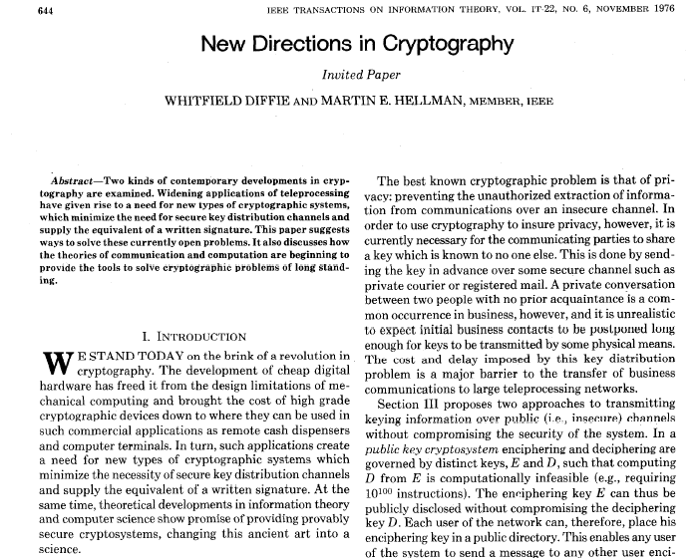

Slide 11
New directions…
Main ideas:
Some problems exhibit asymmetry – easy to compute, but hard to invert (factoring, RSA, group exponentiation, …)
Use this asymmetry to enable two parties to agree on a shared secret key via public discussion(!)
Key exchange

Slide 12
Key exchange
…
…
k
Enc_{k}(m)
k
Secure against an eavesdropper who sees everything!

Slide 13
More formally…
transcript
· · ·
k∈{0,1}^{n}
k∈{0,1}^{n}
Security goal: even after observing the transcript, the shared key k should be indistinguishable from a uniform key

Slide 14
Formally
Fix a key-exchange protocol Π and an attacker (passive eavesdropper) A
Define the following experiment KE_{A,} _{Π}(n):
Honest parties run Π using security parameter n, resulting in a transcript trans and (shared) key k
Choose uniform bit b. If b=0, then set k’=k; if b=1, then choose uniform k’∈{0,1}^{n}
Give trans and k’ to A, which outputs a bit b’
Exp’t evaluates to 1 (A succeeds) if b’=b

Slide 15
Security
Key-exchange protocol Π is secure (against passive eavesdropping) if for all probabilistic, poly-time A it holds that Pr[KE_{A,} _{Π}(n) = 1] ≤ ½ + negl(n)

Slide 16
Notes
Being unable to compute the key given the transcript is not a strong enough guarantee
Indistinguishability of the shared key from uniform is a much stronger guarantee…
…and is necessary if the shared key will subsequently be used for private-key crypto!

Slide 17
Diffie-Hellman key exchange
G, q, g, h₁
h₂
k₁ = (h₂)^{x} = g^{yx}
k₂ = (h₁)^{y} = g^{xy}
(G, q, g) ← G(1^{n})
x ← ℤ_{q}
h₁ = g^{x}
y ← ℤ_{q}
h₂ = g^{y}

Slide 18
In practice…
G, q, g
h₁
h₂
k₁ = (h₂)^{x} = g^{xy}
k₂ = (h₁)^{y} = g^{xy}
x ← ℤ_{q}
h₁ = g^{x}
y ← ℤ_{q}
h₂ = g^{y}

Slide 19
Recall…
Decisional Diffie-Hellman (DDH) problem:
Given g^{x}, g^{y}, distinguish g^{xy} from a uniform group element

Slide 20
Security?
Eavesdropper sees G, q, g, g^{x}, g^{y}
Shared key k is g^{xy}
Computing k from the transcript is exactly the computational Diffie-Hellman problem
Distinguishing k from a uniform group element is exactly the decisional Diffie-Hellman problem
⇒ If the DDH problem is hard relative to G, this is a secure key-exchange protocol!

Slide 21
A subtlety
We wanted our key-exchange protocol to give us a uniform(-looking) key k∈{0,1}^{n}
Instead we have a uniform(-looking) group element k∈G
Not clear how to use this as, e.g., an AES key
Solution: key derivation
Set k’ = H(k) for suitable hash function H
Requirements on H omitted here…

Slide 22
Modern key-exchange protocols
Security against passive eavesdroppers is insufficient
Want authenticated key exchange
This requires some form of setup in advance
Modern key-exchange protocols provide this
We will return to this later

Slide 23
The public-key setting

Slide 24
The public-key setting
A party generates a pair of keys: a public key pk and a private key sk
Public key is widely disseminated
Private key is kept secret, and shared with no one
Private key used by the party who generated it; public key used by everyone else
Also called asymmetric cryptography
Security must hold even if the attacker knows pk

Slide 25
Public-key distribution I
pk
pk
pk
pk, sk

Slide 26
Public-key distribution II
pk
pk, sk

Slide 27
Public-key distribution
Previous figures (implicitly) assume parties are able to obtain correct copies of each others’ public keys
I.e., the attacker is passive during key distribution
We will revisit this assumption later

Slide 28
Primitives
 | Private-key setting | Public-key setting
Secrecy | Private-key encryption | Public-key encryption
Integrity | Message authentication codes | Digital signature schemes

Slide 29
Addressing drawbacks of private-key crypto…
Key distribution
Public keys can be distributed over public (but authenticated) channels!
Key management in large systems of N users
Each user stores 1 private key and N-1 public keys; only N keys overall
Public keys can be stored in a central directory
Applicability in “open systems”
Even parties who have no prior relationship can find each others’ public keys and use them

Slide 30
Why study private-key crypto?
Private-key cryptography is more suitable for certain applications
E.g., disk encryption
Public-key crypto is roughly 2-3 orders of magnitude slower than private-key crypto
If private-key crypto is an option, use it!
Private-key crypto is used for efficiency even in the public-key setting

Slide 31
Public-key encryption
pk
pk
c
pk
pk, sk
c ← Enc_{pk}(m)
m = Dec_{sk}(c)

Slide 32
Thank You!
Next Class
Mandatory reading for the next class
https://www.hjp.at/doc/rfc/rfc5021.html
10 June 2020
32

Slide 33


Rajashree S
Computer Science and Engineering
PES University, Bengaluru
10 June 2020
33

